Slide 1
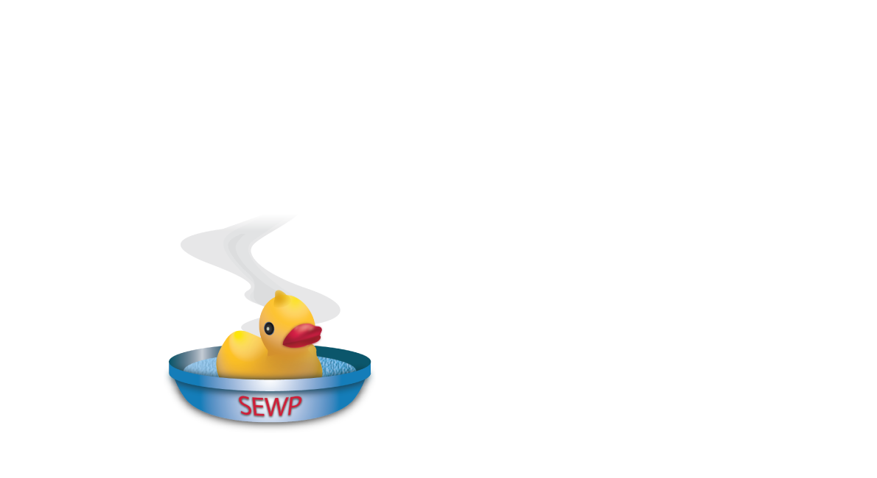
SEWP VI Onboarding
Orientation Q&A, 08/06/2026

Slide 2
General Webinar Information
  This webinar addresses questions submitted over the past 2 weeks
  There will not be a posting of all questions with answers
    The document “SEWP VI Auxiliary information 080626” can be downloaded from https://www.sewp.nasa.gov/sewpvi and contains the detailed documentation summarized in this webinar
      Referred to as “Auxiliary Document” in this slide deck
    Questions sent to sewp6@sewp.nasa.gov or submitted via slido during this and future webinars will be similarly responded to in updated “SEWP VI Auxiliary information” files
    Most emails will be responded to with a note to review the “SEWP VI Auxiliary information …” files and attend future webinars for answers to submitted questions.
  This and future webinars will be recorded and posted on-line

Slide 3
Section 1: Terminology
This section is a repeat of the terminology provided with the initial webinar and is included in the “Auxiliary Document”

Slide 4
Section 2: External Communication Paths
This section is primarily a repeat of the information provided with the initial webinar
Note that NASA does not refer or endorse any outside consultants or companies to assist Contract Holders (CHs)
  NASA does recommend due diligence particularly concerning SEWP experience
Ensure your firewall has fully whitelisted all emails for @sewp.nasa.gov or @nasa.gov domains

Slide 5
Section 3: General Usage Information
SEWP V’s FY 25 obligated value was $12B; currently over 18% ahead in FY26
Total value to date for SEWP V: $88 Billion
Used by every Government Agency.
In FY25 the top 5 were:
  Department of Defense (including Navy, Air Force and Army)
  Department of Homeland Security
  Department of Justice
  Department of the Treasury
  Department of Veterans Affairs
30,000 Active Customers (50+ added daily)
FY25: 51,000 contract actions (new order and modifications to existing orders)
Average 2,700 RFQs monthly; Peak of over 4,000 in July

Slide 6
Section 4: Categories and Scope
Each Category is separate with its own scope and slate of Contract Holders
An updated version of Exhibit 4 will be provided. CHs will indicate any small business designations by NAICs code in Exhibit 4.
  NASA will verify submitted information
  CH business size in Exhibit 4 for Contract level NAICs code is the default size
  Requests availability are determined by customer beginning with selection of Category, NAICS and business size
COTs Software is a Product
  Software development is a service
Theoretical scope questions will not be responded to.
  Customers with scope questions can submit their requirement to help@sewp.nasa.gov

Slide 7
Section 5: Upcoming Webinars and In Person Meeting
In depth Webinars are planned in upcoming weeks and months
In-Person Kickoff meeting is Nov 2-4, 2026, in Louisville, Kentucky.
  Election Day is that week – we encourage voter participation via early voting or mail-in voting
  Contract Holders are required to attend: no more than 2 attendees per CH.
  An attendee can represent more than one company; e.g. Prime and JV company they are aligned with.
  The registration link and hotel information will be sent in the coming weeks

Slide 8
Section 6: PM/DPM/Program Office Interaction (1 of 2)
Information on how to submit Program Manager (PM) and Deputy Program Manager (DPM) Points of Contacts will be provided
  NASA does not review resumes, etc.
A PM can only be a PM for one CH (UEI)
DPMs are not limited and a PM for one CH can be a DPM for another
All interactions with NASA regarding SEWP must be centered on the SEWP CHRM Team and the CH PM/DPM
PMs and DPMs do not have to only work on their SEWP contracts. That is a business staffing decision made by each CH.
A PM / DPM may be an employee of an associated company (e.g. a 1099 contract administrator)
  Must meet all criteria including a CH email address
The CHOP functionality will be addressed in upcoming webinars, meetings and documentation

Slide 9
Section 6: PM/DPM/Program Office Interaction (2 of 2)
Initial access to the CHOP will begin in August. Applications, reports, documentation etc. will be added throughout the on-boarding process
It is highly recommended that CHs attend all webinars and carefully read all provided documentation in order to best prepare for SEWP VI processes and activities
  The CHOP site will be addressed in future webinars and documentation
  The Program Performance metrics will be addressed in future webinars and documentation

Slide 10
Section 7: Dates
Contract award date is the date of the Contracting Officer’s (CO’s) electronic signature in box 31a of the SF1449.
Effective date is the start of the contract Period of Performance (POP).
  Currently expected to be Nov. 1, 2026.
Active date is on or after the effective date
  Active date is CH dependent
  Active date occurs when all Onboarding Checklist tasks are completed
No quotes can be submitted and no orders processed until the CH active date
Customers can submit requests (RFIs, RFQs. Etc.) beginning on the effective date
  CHs cannot respond until their active date
It is possible for the first orders to be submitted as early as the effective date

Slide 11
Section 8: Customer Outreach
CHs can announce and market their contracts.
  SEWP PMO does not review and/or approve CHs marketing
All CHs will receive signage they can use when exhibiting at conferences
SEWP PMO will conduct customer webinars
  CHs can refer customer to help@sewp.nasa.gov to:
    answer questions
    attend webinars
    set-up agency training
  CHs cannot participate in NASA SEWP/customer interactions

Slide 12
Section 9: Contracts
Contract number was in the subject line of the email to which the signed1449 was attached and is the name of the attached1 449 file
Each contract is tied to a company and category.
There is no NTP (notice to proceed) at the contract level.

Slide 13
Section 10: Deliverables (1 of 3)
Category specific deliverables; e.g. Exhibit 4, need to be submitted for each category in which a CH holds a contract
Non-Category specific deliverables; e.g. C-SCRM, Attachment H, ISO 9001, etc. only require one submission per CH
  Available at https://www.sewp.nasa.gov/sewpvi/
All deliverables must be submitted post-award.
  Proposal related deliverables are not substitutes for the contract deliverables
Submission of any and all deliverables must wait until instructions are provided at upcoming webinars and/or emails and/or other documentation
  The 60 day clock for initial deliverables will start when the instructions are provided by the SEWP PMO
  Due date for novated companies will be discussed at a later date

Slide 14
Section 10: Deliverables (2 of 3)
C-SCRM Attestation Form is the Attachment J deliverable
  Available at https://www.sewp.nasa.gov/sewpvi/
  All CHs in all categories and business sizes must submit either the C-SCRM attestation form or ISO 20243 certificate
  ISO 9001:2015 certification is a separate deliverable and not an alternate to the C-SCRM deliverable
  ISO 20243 can be either O-TTPS Self-Assessed or the O-TTPS Third-Party Assessed Certification
Attachment H will be available TBD
Attachment L (Climate Change Risk Management Plan) will be clarified in the upcoming Contract modification
DEIA Plans were removed during an RFPO amendment and are therefore not required

Slide 15
Section 10: Deliverables (3 of 3)
Submitting initial Providers and Technology Refreshment (TR) request is a necessary step to be active. There is no due date
  This process will be discussed in upcoming webinar
Setting up a SEWP web page is a necessary step to be active. There is no due date
  See “Auxiliary Documentation” for specific website requirements
ISO 9001 for all 3 categories and CMMI for Category B, only, are required within one year for all CHs regardless of business size.
The requirements for ISO 9001 and CMMI, including JV/Prime relationships and CMMI specific requirements, are spelled out in the RFP/Contract (reiterated in “Auxiliary Documentation” )
  Offerors may use the ISO 9001:2015 and/or CMMI certifications of a Parent Company, Affiliate, Division, and/or Subsidiary within a corporate structure with an accompanying Meaningful Relationship Commitment Letter.

Slide 16
Section 11: Agency Specific Requirements/CMMC
CMMC is not a contract level requirement
  Any CMMC level requirement will be stated at the request/order level
DCAA audits and other agency-specific requirements are handled by the issuing agency

Slide 17
Section 12: Historical Information / Projected Use
Historical information was provided in Section 3
  Historically SEWP has grown in all but one of its 33 years of existence
  Strong SEWP V usage in FY26 and broad customer anticipation for SEWP VI including the increased services scope suggests a continued growth curve
NASA has no special insight into specific Agency projected requirements and possible contract vehicle use
  Many Agencies provide their own IT projections on agency websites
NASA SEWP does not post PWS (Performance Work Statements), Request for Quotes (except to the companies the customer has poster to) and orders.
  FPDS can be utilized to view FPDS-level order information
  Issuing Agencies, not NASA, own their data including PWS, RFQs and orders

Slide 18
Section 13: SEWP V to VI Transition
SEWP V Contracts are separate from SEWP VI
No SEWP V CH related data will be transferred from SEWP V to VI
A SEWP V quote cannot be used from a SEWP VI order and vice versa
During the crossover period, Government customers will decide on their best acquisition approach in selecting SEWP V vs. SEWP VI
SEWP V CHs should review all of the SEWP VI documentation and webinars to determine their internal changes needed to align with their SEP VI contracts.

Slide 19
Section 14: Quote/Order Process (1 of 4)
Customer determines the NAICs code and business size based on their requirements, policies and processes
Eligibility of a CHs for a requirement is based initially on the Category, NAICs code and business size
A product requirement under Category A and a service requirement under Category B would require 2 separate RFQs
Fair opportunity, including sole source requirements, is determined by the customer based on FAR 16.505(b)
Leasing is handled at the order level
SEWP requirements are not posted on sam.gov or other non-SEWP site
There is no API for access to SEWP requirements
  CHs and third part companies have built interfaces to assist the RFQ/ordering process

Slide 20
Section 14: Quote/Order Process (2 of 4)
Items/services do not need to be on contract when a request is issued
  Items/services MUST be on contract when a quote is submitted
  CHs are encouraged to place all offerings on contract for customer visibility
Customers may use alternative methods to obtain quotes; but
  The only recommended method is the SEWP Quote Request Tool
  CHs cannot recommend a customer use an alternate approach
If a customer request is questionable; e.g. scope, notify the SEWP PMO and we will work with the customer to resolve any concerns
Delivery times on a quote must be met.
All orders must be sent to the SEWP Program Office
  A SEWP order cannot be processed until SEWP PMO has assigned a SEWP Control Number (SCN)

Slide 21
Section 14: Quote/Order Process (3 of 4)
Average of 125 requests a day (peak of 200 daily in July)
  Category B and C will see fewer but more complex requirements
  Default response time is 5 days
    Customer has full control over the number of days; SEWP recommends they consider the complexity of the requirement when setting response time
    Minimum is 1 day; Maximum is one year
There is no minimum requirement for responding to RFQs
  CHs should provide quotes when they have made a business decision to do so
  If no quotes are submitted in a year, the SEWP PMO will take that into consideration as to whether the CH is still an active concern
CHs that are JV or with CTAs should be prepared to provide customer requested information at the order level; e.g. JV agreement

Slide 22
Section 14: Quote/Order Process (4 of 4)
Contract level limit ($20B per contract) and Category level limits (Cat C order limits) will be monitored by the SEWP PMO
All CHs in all categories must accept credit cards
  The Government cannot be required to use a third party payment system
  While a majority of credit card orders are limited to an agency micro-purchase limit, some CO’s have up to 6 figure credit card limits
Partial shipments are governed by the contract clause:A.1.19 PARTIAL SHIPMENTS (See RFP/Contract and “Auxiliary Documentation”
There is no ERP (Enterprise Resource Planning) contract level requirement

Slide 23
Section 15: Fee
SEWP Fee is included in the price of your offerings and cannot be separately listed.
  All offerings including labor rates, ODCs, etc. include the fee
  The SEWP fee is currently 0.34% (Use 0.0033885 to not pay a fee on the fee)
Payment of the fee is based on the invoice and subsequent payment.
  Once a payment is made (partial or full), the fee associated with that payment is due with the next quarterly CH payment.
  Once assigned, CH’s Customer Number will appear on the CHOP under reports/surcharge fee/statement tabs and will be emailed.
  SEWP V CH Customer Numbers will remain the same in SEWP VI.
  Category A Customer Numbers will be assigned first
  You do not need the number until three months after you receive your first order payment

Slide 24
Section 16: Strategic/BPA Storefronts
Strategic Storefronts and BPA Storefronts may be established by agencies to define offerings aligned with their strategic requirements.
This topic will be addressed in future meetings and documentation

Slide 25
Section 17: Database of Record, CLINs and Technology Refreshment
SEWP Database of Record contains all relevant information on approved offerings for each CH/Contract including pricing, description, original part number, UNSPSC code, etc.
  All offerings must be in the Database of Record prior to quoting.
  Open Market items are not permitted in SEWP.
  Offerings must be in scope, properly priced and properly described and approved by the SEWP PMO.
The Technical Areas in the RFP were examples for the purposes of proposal and evaluation. They do not carry over into the operational SEWP VI processes.
Technology Refreshment (TRs) will be fully covered in upcoming webinars
  All CHs in all Categories must submit TRs to place their offerings on contract.
CLIN (Contract Line Item Number) refers to a unique instance of a part number, labor category, service offering, etc. with a description and price specific to that instance.

Slide 26
Section 18: Providers
A provider is a company with one or more offerings (product, solution, services, etc.) on one or more SEWP contracts.
This topic will be addressed in future meetings and documentation

Slide 27
Section 19: AbilityOne
This topic will be addressed in future meetings and documentation

Slide 28
Section 20: Dormant Status
A.1.40 DORMANT STATUS
Contractors not in compliance with SEWP Program Performance, underperforming, or not active for at least 12 months will first be placed in Dormant status. Not active is defined as either not responding to solicitations, market research inquiries, attending Program management meetings, and/or being found non-responsible in accordance with FAR 9.104. If Dormant Status is activated, the Contractor is not eligible to participate or compete in any subsequent task order solicitations until the Contractor is removed from Dormant Status by a SEWP Contracting Officer; however, Contractors placed in Dormant Status shall continue performance on previously awarded and active task orders.

Slide 29
Section 21: Off Ramp
NASA reserves the right to Off-Ramp under-performing Contractors. Contractors that are Off-Ramped have no active task orders under their SEWP Contract at the time of the Off-Ramping. All attempts for corrective action will occur with the SEWP PMO while the contractor is in Dormant status. Additional information for off ramping is located in Attachment B- Program Performance. Contractors under more than one SEWP Category will only be Off ramped from the SEWP Category where the under-performance issues have occurred. Off-ramping methods may result from one of the following conditions:
1. After a Contractor is placed in Dormant Status and the Contractor has completed all previously awarded task orders under SEWP.
2. Responsibility Determination IAW FAR 9.104.
3. Debarment, Suspension, or Ineligibility as defined in FAR Subpart 9.4.
4. Contractor who fails to meet the requirements of performance, deliverables, or SEWP compliances (Attachment C).
5. Lack of activity with no orders within the last 12 months.
6. Partaking in any other activities which may be prohibited under the SEWP terms and conditions.
7. Novation resulting in a Contract Holder having multiple contracts within one Category.
8. Mutually agreed upon between the Contractor and Government.

