Slide 1

NASA SEWP VI
Contract Holder Orientation, July 2026

Slide 2


Slide 3

NASA SEWP Godfathers

Slide 4

Scientific and Engineering Workstation Procurement
(SEWP og)

Slide 5

Why The Duck?

Slide 6
A Plan Was Hatched (or Cooked Up)

Slide 7
Glossary
  SEWP: Solutions for Enterprise Wide Procurement
  SEWP PMO: SEWP Program Management Office
  Contract Holder (CH): Company awarded a SEWP Contract
  Provider: Company with one or more products and/or services on at least one SEWP Contract
  Issuing Agency: Government Agency that issued an order against a SEWP Contract

Slide 8
Glossary
  CHRM: Contract Holder Relationship Manager
  STAR: Strategic Training Acquisition Resources
  SPACE: SEWP Procurement Administration & Contract Execution
  CHOP: Contract Holder Only Page
  PROP: Provider Only Page
  SEWP Marketplace: On-line manifestation of SEWP Database of Record

Slide 9
NASA SEWP Mission
The SEWP Program enables NASA and all Federal Agencies to efficiently and effectively acquire mission critical Information Technology, Communication and Audio Visual (ITC/AV) solutions and services via a suite of contracts encompassing a diversity of business sizes and offerings. SEWP's customized reporting, streamlined procurement processes, innovative applications, premier customer service, acquisition insight and Government/Industry partnership deliver the
Best-in-Class value for the Federal Government.

Slide 10
NASA SEWP Vision
SEWP is the Pre-eminent World-class Leader utilizing a broad range of comprehensive and intuitively accessible processes and methodologies to manage, inform, display and acquire state of the art technology solutions via the visionary SEWP Marketplace and Agency Storefronts.

Slide 11
What is SEWP?
Multi-award suite of Government-Wide Acquisition Contracts
NASA SEWP V stats:
140+ Contract Holders / 100+ Small Businesses
13,000+ OEMs (Providers)
Annual Obligated Value Over $12. B (FY25)
Total value to date: $87 Billion
Utilized by every Government Agency (30,000+ customers)
Contract Vehicle for ITC/AV (Information Technology, Communications and Audio/Visual) Product, Solutions and services
Program Management Office (PMO) to provide support and information throughout the Acquisition Process

Slide 12
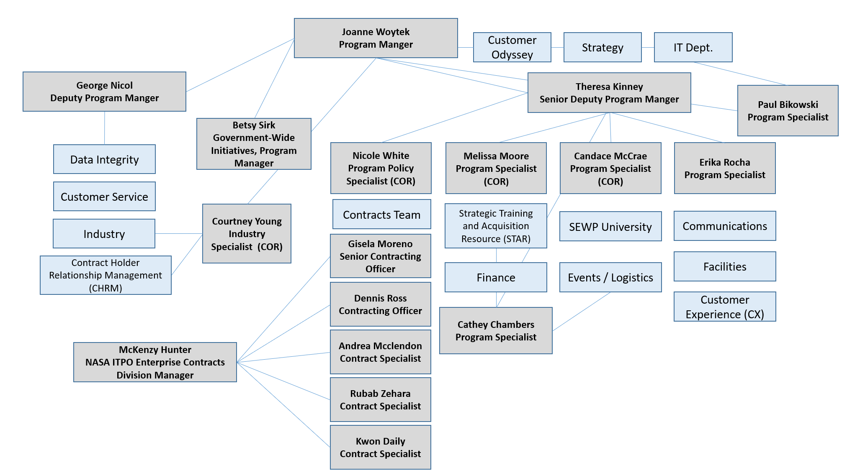
SEWP PMO

Slide 13
SEWP PMO Customer Role
The NASA SEWP Program Management Office (PMO) performs many roles in support of Government Acquisition staff:
  Manage SEWP contracts.
  Mediate actions between Government and Industry.
  Facilitate the Acquisition process.
  Recommend best approaches to Acquisition issues.
  Inform the Government customer on both overall Contract use and specific policy-related aspects of their acquisition.
As a central Program for decentralized Government Acquisition, SEWP is an information channel between Industry and Government and between Agency decision-makers and their Acquisition teams.

Slide 14
SEWP PMO Industry Role
The NASA SEWP Program Management Office (PMO) performs many roles in support of Industry:
  Oversee and monitor Contract Holder Relations.
  Mediate actions between Government and Industry.
  Support, track, and verify supply chain relationships.
  Expedite addition of current and emerging technology, based on customer requirements.
  Monitor and inform on Acquisition policies and best practices.
  Manage Industry interaction in support of all Federal Agencies.

Slide 15
SEWP VI Categories
CATEGORY: A
CATEGORY: B
CATEGORY: C
ITC/AV (Information Technology, Communications and Audio Visual) Solutions
Enterprise-Wide ITC/AV (Information Technology Communication and Audio Visual) Service Solutions
ITC/AV Mission-Based (Information Technology Communication (ITC) and Audio Visual (AV)) Services
Task Orders are placed by Category. All Contract Holders (CH) within a Category are eligible for a requirement if, as identified in Exhibit 4, they meet the task level requirement for NAICs code and business size
Each contract has an individual $20 Billion contract limit
All actions are governed by FAR 16
Technical area information was solely used for proposal evaluation purposes and will not be utilized for any other purpose

Slide 16
Category A Scope
This category represents a broad suite of ITC/AV solutions, i.e. technology in which there is an intertwining of products, such as a laptop, and services, such as maintenance and installation, and engineering services
The scope of Category A is the full breadth and depth of ITC/AV technology and solutions range of technology and therefore all similar and related technologies are within scope of this Category
Services may be provided without limitation if they are product-based or with limitation if they are general services as part of a product solution.

Slide 17
Category B Scope
The Category B scope provides Federal Agencies with customized Enterprise-Wide Strategic Solutions that improve and enhance the Agency ITC/AV infrastructure
All services which adhere to the definition of ITC/AV services and encapsulate an enterprise-wide solution, are within scope and may be provided to meet an agency’s particular mission needs.
Ancillary products are limited to support an overall enterprise-wide services requirement.

Slide 18
Category C Scope
The Category C scope provides Federal agencies with customized Solutions at a Mission/Program level that improve and enhance an ITC/AV infrastructure
All services which adhere to the definition of ITC/AV program level services are within scope and may be provided to meet a particular mission need.
Ancillary products are limited to support an overall mission-based services requirement.

Slide 19
Product Solution Availability
SEWP is ‘Catalog by Request’ not ‘Request by Catalog’
  Quote Request tool available on-line
  Quotes are verified against contract catalog
Dynamic Catalog
  Products/Services added to contract as contract line items (CLINs) based on customer requests
  Contract Holder requests to add CLINs are approved or denied daily
  On-line contract database of record
  Note: Fair and reasonable pricing determined at the quote/order level
    SEWP will provide pricing information to support customer determination

Slide 20
SEWP Strategic Storefront
Defined set of objective filters
Provides a snapshot of items and pricing available by the Contract Holders in the Storefront
Does not require a formal order/agreement between Agencies and Contract Holders
  Agency may include Agency specific Terms and Conditions
  Agency may require formal agreement / procedures
  Orders are issued against the Prime SEWP Contract
Includes a built-in shopping cart feature for direct micro-purchases

Slide 21
SEWP BPA Storefront
Provides a snapshot of items and pricing available by the Contract Holders in the BPA
Agency-designated access to BPA within their SEWP Storefront
  BPA Clauses and Terms and Conditions transfer to all orders
  Orders are issued against the BPA
Access is requested by the Agency
Includes a built-in shopping cart feature for direct micro-purchases

Slide 22
Procurement Lifecycle
Quotes are the Contract Holder’s responsibility:
  Technically meets requirements
  All quoted Items must be on your contract and priced at or below contract price at the time of the quote
  Price cannot be raised after the quoting period
Order Processing
  Government Agency submits orders to NASA SEWP Program Management Office (PMO)
  Orders cannot be fulfilled until verified and approved by NASA SEWP
Post-Order Support
  Assist with any order issues until resolved to customer’s satisfaction
  Delivery time on the quote must be met

Slide 23
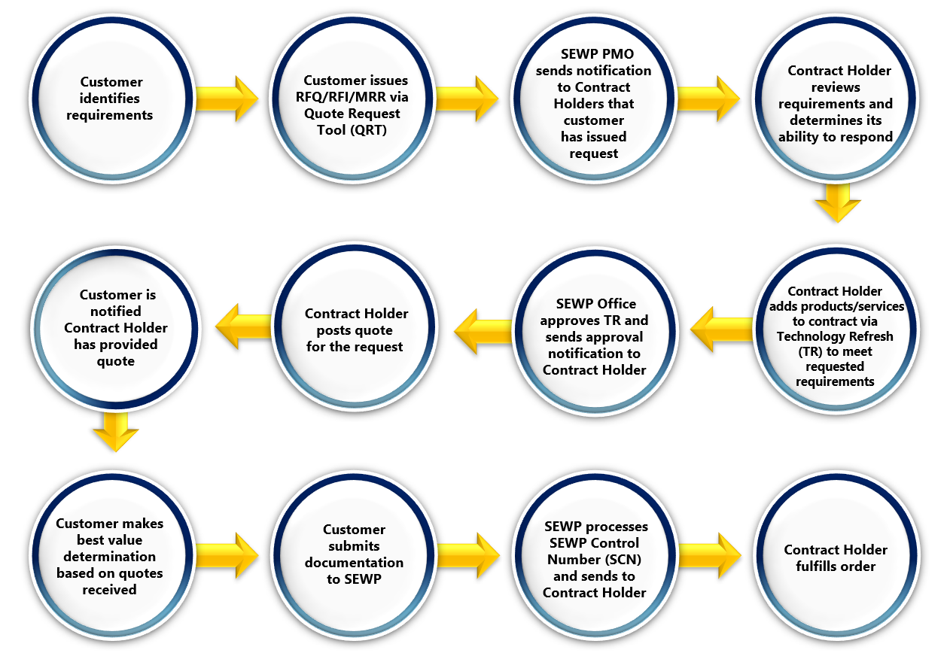
Procurement Lifecycle

Slide 24
Communication
Interactions with NASA SEWP Program Management Office (PMO):
  Your Company’s Program Manager is the central Point of Contact for all things SEWP
  All communication with the NASA SEWP Program Management Office (PMO) must be sent to sewp6@sewp.nasa.gov include and be cleared by your Program Manager
  All emails must be sent to sewp6@sewp.nasa.gov
Interactions with Government Customers
  Communications must be professional and business-like
  If the customer needs assistance provide them the SEWP help email and phone number: help@sewp.nasa.gov / 301-286-1478
Performance including Communications is taken seriously and tracked and reported on by NASA SEWP

Slide 25
Ground Rules
NASA SEWP PMO is Contract Holder Neutral
Provider no Recommendations to Customer Agencies
  Except: Business Size differentiations
No Preferential Treatment – First In First Out (FIFO)
No Cold Calls to Government Personnel
  Will take calls from government
Contract Holders advertisements may use Contract Holder specific SEWP Logo
  Logo must direct link to NASA SEWP VI website for program information
  Copy of logo will be sent during onboarding and added to the CHOP
No NASA badging / special access to Government facilities

Slide 26
Keys to Success
Government customer is your primary focus
  Do not over-promise or under-perform
SEWP Processes are in place for a reason
  Performance tied to following those processes
  Very Flexible
  Very Constrained
Respond to Request for Quotes and Information and Market Research (RFQ/RFI/MRR)

Slide 27
CHRM Team Role
Point of Contact for all CHs at SEWP PMO
Communicate with CHs any changes to SEWP Policy
Respond to CH inquiries
Assist with resolution of customer/CH issues
  Request for delivery status
  Quoting issues
Train Contract Holder SEWP staff

Slide 28
Program Manager Role
Manage Contract Holders day-to-day SEWP operations
Responsible for ensuring that Contract holder follows SEWP Policies and procedures
Resolving customer issues
Must be solely dedicated to one Contract Holder
Contract Holder Must Identify a Program Manager (PM) & Deputy Program Manager (DPM)
PM and DPM are the communication link for all PMO inquiries

Slide 29
What is the CHUM?
Contract Holder User Manual (CHUM)
SEWP Guidebook on Day-to-day operations
General SEWP Rules & Guidelines
Contract Information
Financial Information

Slide 30
What is the CHOP?
Contract Holder Only Page (CHOP)
The CHOP is a website for Contract Holders (CH)s only
It has tools to facilitate the quoting and order process
It will also be a repository of information applicable only to CHs
CHOP access will be granted to the Program Manager and Deputy Program Manager during onboarding
Access to the site will then be managed by the PM/DPM and designated administrative users

Slide 31
Reports
Contract Holders Receive several reports emailed or downloadable
Annually, Monthly, Daily, Weekly
Reports include but not limited to:
  From Program to Contract Holder
    Order processed / order attachment
    Tickler reports (will be enumerated later); e.g.: Overdue orders
    Weekly / Monthly summary reports
  From Contract Holder to Program
    Surcharge Payment report
    Order Status Report/Report of Work

Slide 32
Deliverables
Exhibit 4 – resubmission – Onboarding Process
60 days after Award
Attachment J - Cybersecurity-Supply Chain Risk Management(C-SCRM) Plan or ISO 20243 Certificate
Attachment H - AbilityOne
ISO 9001-2015
CMMI
Instructions for submissions and due dates forthcoming for identified deliverables

Slide 33
ISO 9001:2015 & CMMI
ISO 9001-2015 – All Categories
CMMI – Category B Only
Must have or be in progress at time of proposal
Required 12 months post award
No Certification
Year 1 – Prohibited from responding if ISO 9001:2015 or CMMI is part of task order requirements
After 12 Months – Failure to obtain certificate will result in Contract Holder being placed in Dormant status

Slide 34
Fee
NASA SEWP’s program budget is self-contained; the program receives no funding from NASA’s budget.
Effective October 1, 2020, SEWP’s procurement fee is 0.34%.
  This fee should be included in product pricing and services, not as a separate line item.
  Please use the calculation of 0.0033885 on each order, as SEWP does not charge a surcharge fee on the surcharge fee.

Slide 35
Surcharge Fee Payment Process
Contract Holder quarterly surcharge fee requirement
  Quarterly, the Contractor shall be responsible for sending a payment to NASA/Information Technology Procurement Office, SEWP, Code LP013, reflecting the total administrative handling fee collected during that period. The Contractor will be only responsible for forwarding payment on handling fees invoiced and collected. The Contractor shall determine the timing of the initial quarterly payment. (A.1.26(e))
  Surcharge fee payments should be managed and tracked internally by the Contract Holder’s company. Please do not rely on SEWP late notices as a reminder that a balance is due.
  Following the receipt of the first order payment from a Federal Agency, the initial surcharge fee payment is due to the SEWP PMO. Thereafter, surcharge fee payments are due on a recurring quarterly basis.
    For instance, if a Contract Holder receives payment for an order from a Federal Agency on July 1, 2026, the quarterly payment to SEWP would be due on October 1, 2026, and then due every three months thereafter.

Slide 36
Surcharge Fee Payment Process
Contract Holders must have their unique Customer Number and Company Name to enter a surcharge fee payment.
  The Contract Holder’s Customer Number will appear on the Contract Holders Only Page (CHOP) under reports/surcharge fee/statement tabs; SEWP’s Finance Team will email the Contract Holder their new, unique Customer Number.
  Incumbent Contract Holder Customer Numbers will remain the same in SEWP VI.

Slide 37
Surcharge Fee Payment Process
Notify SEWP’s Finance Team of all electronic surcharge fee payments.
Contract Holders are required to email a soft copy of the surcharge fee payment backup to: GSFC-DL-sewp-finance@mail.nasa.gov
Surcharge fee payment backup must be in an Excel worksheet.
Coordinate with the company’s bank to avoid potential payment rejections.
All SEWP communications will be between the SEWP PMO and the Program Manager/Deputy Program Manager (PM/DPM) of each company. The PM and/or DPM is responsible for the communication within their company.

Slide 38
Issuance of New Customer Numbers
Category A Contract Holders will receive their Customer Numbers first. Thereafter, Customer Numbers will be issued to Categories B and C Contract Holders as they receive orders.

Slide 39
Onboarding
A CHRM Representative will be reaching out to you soon to initiate the onboarding process. You will be provided with a checklist to track the following required information/actions:
Identify Program Manager (PM) and Deputy Program Manager (DPM)
CHOP registration
Credit card fee/surcharge percentage
Company logo
Company website with SEWP resources
Exhibit 4 – NAICS Size Standard Crosswalk submission

Slide 40
Timeline
Dates
7/21 – 7/23 | Orientation Webinars
8/10 – 8/14 | Deep Dive Webinars SEWP specific topics
8/17 | PMO Begins Contract Holder Onboarding (Checklist)
Beginning 8/19 | CHRM Team Office Hours webinars Invitations and details will be sent later
Mid August | Sample reports/emails made available
Mid August | Begin TR submissions
11/1 | SEWP VI Period of Performance Begins
11/2 – 11/4 | In-Person Contract Holder Kickoff Meeting Invitation and details will be sent at a later date
Additional Webinars will be scheduled as needed.

