Slide 1

NASA SEWP
Solutions for Enterprise-Wide Procurement
www.sewp.nasa.gov

Slide 2

What is SEWP?
Providing the latest in commercial ITC/AV products and services, the NASA SEWP (Solutions for Enterprise-Wide Procurement) contract vehicle has an outstanding track record of serving up fresh technology for Federal Agencies.
Multi-award suite of contracts
140+ Prime Contract Holders
100+ Small Businesses
10,000+ Original Equipment Manufacturers (OEM) and Service Providers
Annual Obligated Value over FY24 $11.8B
Ability to set-aside to small businesses across all groups at the delivery order level
Government-Wide Acquisition Contract (GWAC)
Authorized by Office of Management and Budget (OMB)
Open to All Federal agencies and Approved Contractors
Utilized by every Federal agency
Contract Vehicle for Information Technology and Communication (ITC) and Audio/Visual (AV) Solutions
Program Management Office (PMO) to provide support and information throughout the Acquisition Process

Slide 3
What Can Be Procured Through SEWP?
In-Scope Categories & Examples of In-Scope Products and Services
Information Technology & Networking
Computer Hardware, Tablets, Network Appliances: Routers, Modems, VOIP, Storage, Security
Software & Cloud
Software, Virtualization and Cloud Computing, XaaS (e.g. SaaS=Software as a Service)
Mobility & Communications
Telecommunication Devices and Services
Supporting Technology
Scanners, Printers, Copiers, Shredders, Associated Supplies and Accessories, Sensors, Health IT
A/V Conferencing
A/V Equipment and Accessories, TVs, Display Monitors, Projectors and Screens
Services
Maintenance / Warranty Site Planning / Installation / Cabling / Product-based Training / Product-based Engineering Services

Slide 4
Dynamic Catalog
‘Catalog by Request’ not ‘Request by Catalog’
Contract database of record
Providers, products and services added daily
Primarily based on customer requirements
More than 10,000+ providers (OEMs and Service Providers)
Over 4,000,000+ Unique Products & Services

Slide 5
Static Strategic Marketplace
When to Create/Set-up
Known set of Specifications / Requirements
Unpredictable Procurement Ordering Cycle
Unpredictable volume and/or funding of products/solutions
Regular standard technology updates are desired
Speed and simplicity of competition of orders for the best prices
Contract Holder Participation
Participation is based on specific objective and contractual requirements
All qualified Contract Holders are included in a Marketplace
Open participation
Sources & Competition
Maximizes competition throughout process
Contract-level line items and pricing in support of Agency requirements
Strategically sourced
Click to Order functionality or consolidated bundling options

Slide 6
SEWP Scoop
HOW LONG HAS SEWP BEEN IN EXISTENCE?

Slide 7
FAR 16.505(b)
The Federal Acquisition Regulation (FAR) is the primary regulation for use by all executive agencies in their acquisition of supplies and services with appropriated funds.
Pre-award activities/verification
Performed at basic contract level
  e.g. business size and financial responsibility determinations, etc.
Provide Fair Opportunity to a full category or any available set-aside
Does not apply to orders under the micro-purchase limit
Process for Fair Opportunity (per FAR) is at CO’s/KO’s discretion
SEWP’s Quote Request Tool is the only RECOMMENDED method
Best-value determination
Brand Name and Sole Source
Brand Name: Posting a justification in the RFQ is required for orders over $30,000
Sole Source: Exceptions and procedures in FAR 16.505

Slide 8
SEWP Contract Structure
Overall
Group A
Groups B/C/D
All SEWP Contracts have same scope
Group A must be solicited separately from the other Groups
NAICS Code 334111
Available set-asides:
WOSB
HUBZone
SDVOSB
Small Business
NAICS Code 541519
Available set-asides:
WOSB
HUBZone
SDVOSB
Small Business
EDWOSB

Slide 9
SEWP Scoop
HOW DID THE DUCK BECOME SEWP’S OFFICIAL MASCOT?

Slide 10
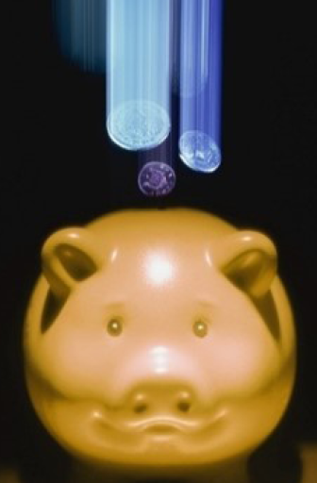
SEWP Pricing
Fair and reasonable product pricing determined at the contract level
Labor Price reasonableness determined by initiator
Contractually required to be equal to or lower than GSA schedule prices
Pricing can be negotiated
Purchases can be consolidated to maximize price discounts
Internal competition results in line-item discounts
Fee included in product price

Slide 11
Quote Verification File
Verifies items are on contract/within scope
Verifies quoted price is at or below contract price
Supply Chain – Level of Provider Authorization
    Authorized/Approved reseller* (Verified with OEM or provider)
    Pricing can be negotiated
    Authorized/Approved Resellers are defined as: A reseller who is known by the OEM, and the OEM
    has verified that a Government purchase from this reseller is considered to be legitimate/authorized.
Trade Agreements Act (TAA)
    Compliant
    Not Compliant (may require exception under FAR 25.401)
    Not Applicable
EPEAT (Electronic Product Environmental Assessment Tool) compliance

Slide 12
Procurement Lifecycle
Pre-Order SUpport
Order Processing
Post-Order Support
Assistance on SEWP Processes
Website/Tool walk-throughs
Review of requirements
Recommendations for best approach
Quote Request Tool
Submission of Request for Information (RFI)/Market Research Request (MRR), Request for Quotes (RFQs), and Request for Marketplace (RFM)
Question and Answer functionality
On-line access to all Quotes and Verification files
Management of Requests: mods, extensions, updates, etc.
All paperwork (Delivery Orders and Modifications) must be sent to SEWP Program Management Office (PMO) via sewporders@sewp.nasa.gov
Orders are verified by PMO
All ordered items are on Contract
All pricing is at or below the contract price
Order processing completed within a few hours of receipt of order
Procurement personnel are notified when the order is forwarded to the Contract holder
Order Status Tool
View status of all past orders
Obtain copies of all past orders and related RFQs
Request order status updates
Assistance with problem resolution
Copy help@sewp.nasa.gov on any issues/questions

Slide 13
Post-Award Guidance
FAR 16.505
SEWP PMO notifies Contract Holders when order is awarded
SEWP PMO does not divulge awardee or award information
Orders less than $6 Million
Post-award debriefs and award notification are at the Issuing Agency’s discretion
Quote Request Tool includes optional Award Notification function
Orders of $6 Million or more
Post-award debriefs shall be provided upon request
Contracting Officer shall notify unsuccessful bidders
Protests (FAR 16.505(a)(10)): No Protest under subpart 33.1; except:
Protests which increase the Scope, Period of Performance, or Maximum Value of the contract
Orders over $25 Million for NASA, DOD, USCG
Orders over $10 Million for all other Agencies

Slide 14
SEWP Scoop
How many Federal Agencies use SEWP?

Slide 15
What's new in SEWP VI?
New Tools & Functionalities
Unrestricted and Small Business
    Category A – ITC/AV Solutions
      Examples – Computer Systems, Networking Equipment, IT Storage Systems
    Category B – Enterprise ITC/AV Services
      Examples: Enterprise Network Services, IT Managed Services, IT Service Management
Small Business Only
    Category C – ITC/AV Mission-Based Services
      Examples – Software Development, Information & Data Analytics Services, Cloud Services
40+ Additional NAICS codes added

Slide 16
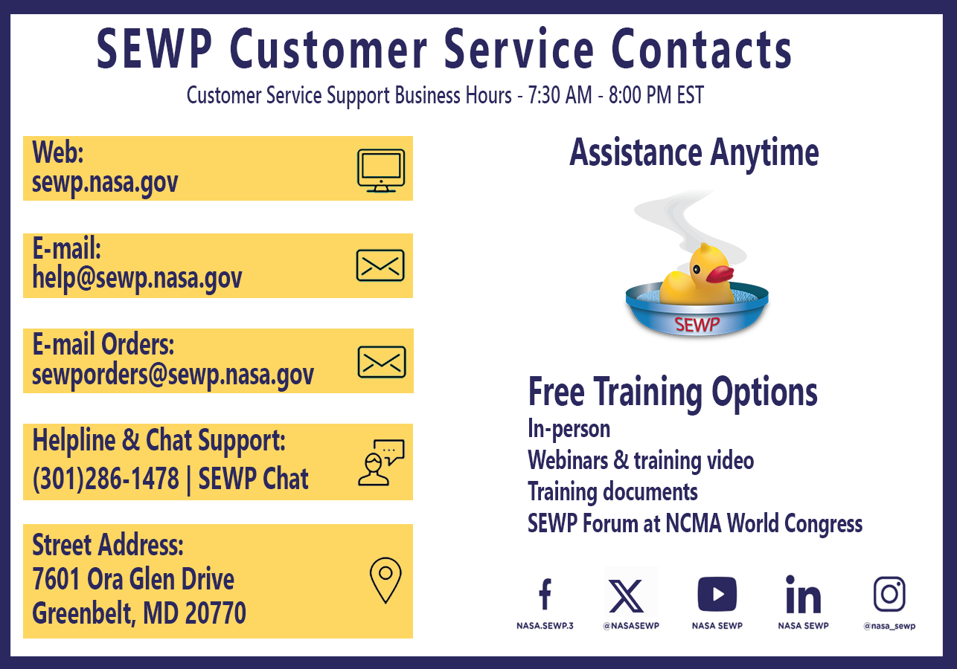
SEWP Contact Info
Notes:
6pm

Slide 17
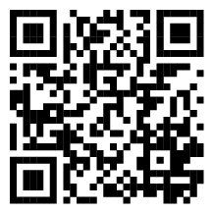
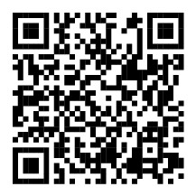
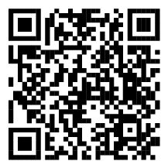
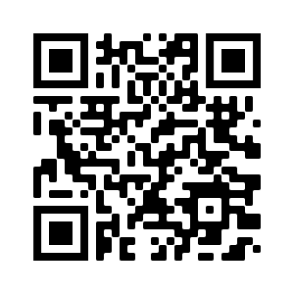
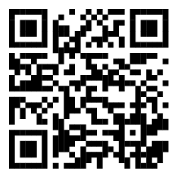
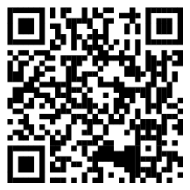
SEWP Toolbox
Scan the QR Codes to view each of the SEWP tools.
Provider Lookup Tool
Market Research Tool
Quote Request Tool (QRT)
ISO 20243
Program Performance
Contract Information

Slide 18
Thank You

